Slide 1
Rockbuster Stealth LLC
Strategic Analysis: Online Video Service

Slide 2
Analysis Objective:
Market Challenge: The rise of streaming services has disrupted the traditional movie rental industry.
Opportunity: Leverage existing movie licenses to launch an online video rental service.
Strategic Goal: Develop a competitive digital platform to retain customers and drive growth

Slide 3
Key Considerations:
Top & Bottom Revenue-Contributing Movies
Statistical Customer Rental Habits.
Customer Geographic Distribution
Customer Variation by Region
Sales Variation by Region
High Lifetime Value Customer Locations

Slide 4
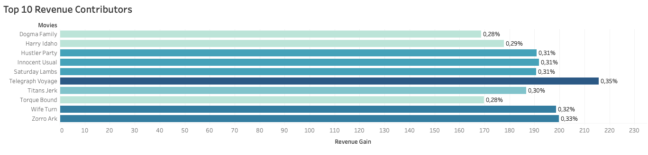
Top Revenue-Contributing Movies
Top 10 revenue driving movies
Total 985 movies
5.7% of total revenue

Slide 5
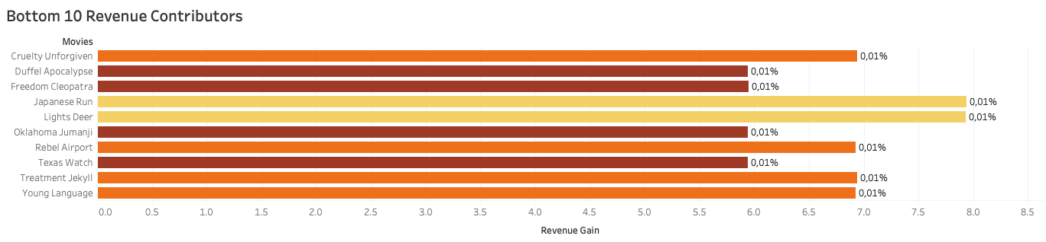
Bottom Revenue-Contributing Movies
Bottom 10 lowest revenue performing movies
0.10% of total revenue

Slide 6
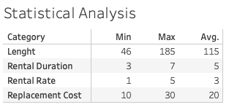
Statistical Customer Rental Habits
Summary of the customer viewing and rental habits.
Avg. Rental Duration & Avg. Movie Length help formulate pricing model and time frame strategy
Analyze to optimise competitive online service offerings.

Slide 7
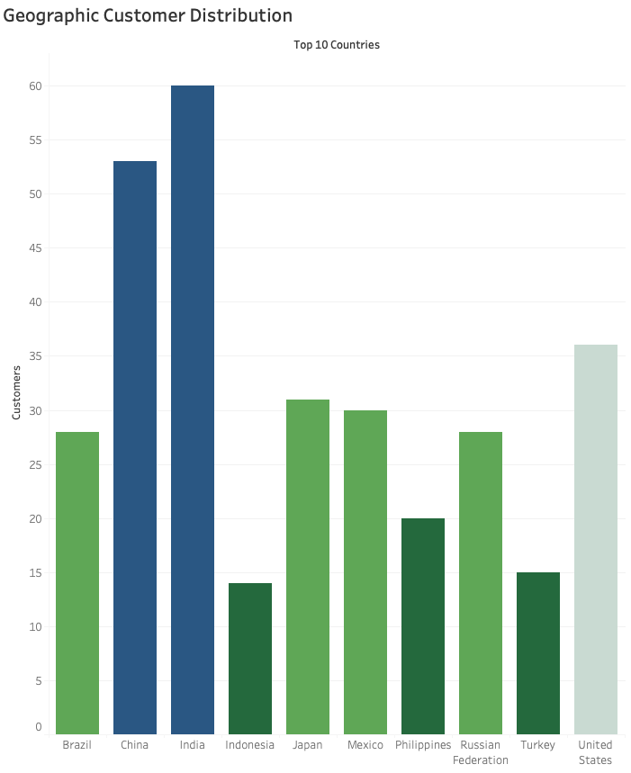
Customer Geographic Distribution
Top 10 countries with highest customer distribution.
Biggest customer base in India and China.
Solid pivot to focus marketing efforts

Slide 8
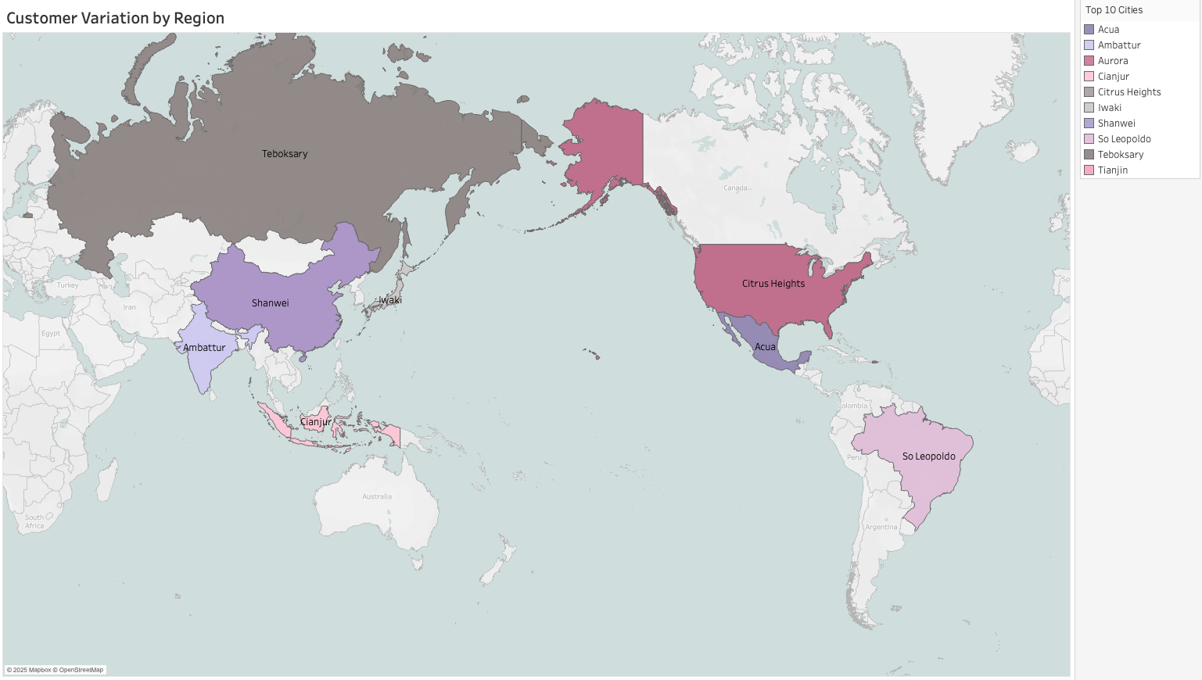
Customer Variation by Region
Top 10 cities in terms of customer density.
Detailed analysis to further optimize regional strategy in customer dense countries

Slide 9
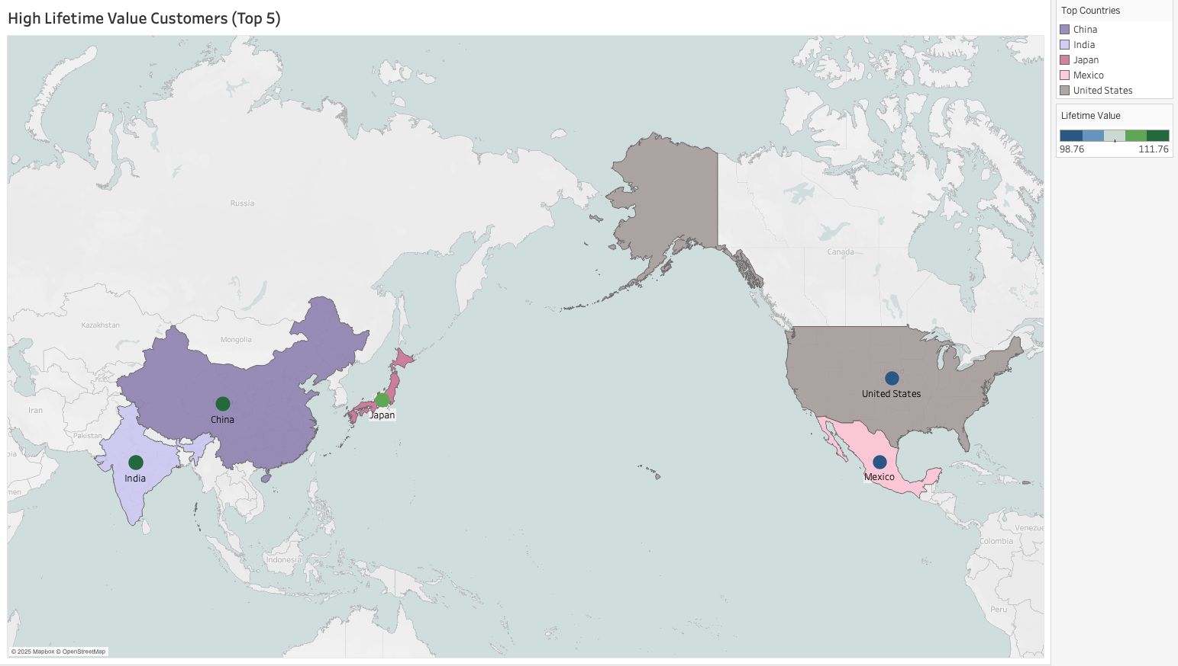
High Lifetime Value Customer Locations
Top 5 highest paying customers in countries with the highest customer distribution.
Highest spenders in India, China and Japan.
Some variation between the high spenders in Asia and Mexico/United States,

Slide 10
Recommendations and Next Steps
Focus the top revenue driving movies to optimize content selection and licensing deals.
Remove lowest revenue performing movies from content selection.
Use customer rental habits (average rental duration)
Tailor marketing and offers to countries with highest customer distribution.
Optimize pricing, marketing and movie selections to cities with dense customer populations.
Target promotions to the most valuable customers in order to maximize retention.
Launch Online Video Service based on above recommendations.

Slide 11
Q&A
Please feel free to contact Konstant van Rensburg (Data Analyst) if you have any further question.
Detailed charts can be found on Tableau Public

